Slide 1


Discovery of Structural Variation with Next-Generation Sequencing
Alexandre Gillet-Markowska
Alexandre.gillet-markowska@upmc.fr
Gilles Fischer Team – Biology of Genomes UMR7238
Laboratory of Computational and Quantitative Biology
Université Pierre et Marie-Curie, Paris

Slide 2
outline
Structural variations (SV)
(ii) SV detection technologies
(iii) Read pairs: 2 types of Illumina genomic DNA libraries
(iv) SV detection using Read pairs
(v) Polymorphic SV Structural Variations (SV)

Slide 3
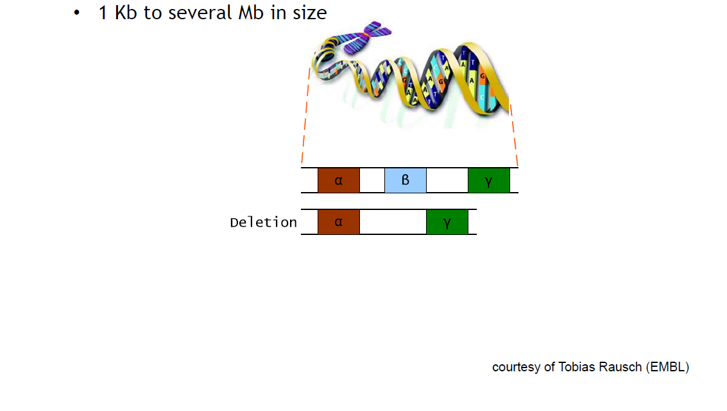
Structural Variations (SV)
¹
¹Yes, the minimal size is arbitrary…

Slide 4
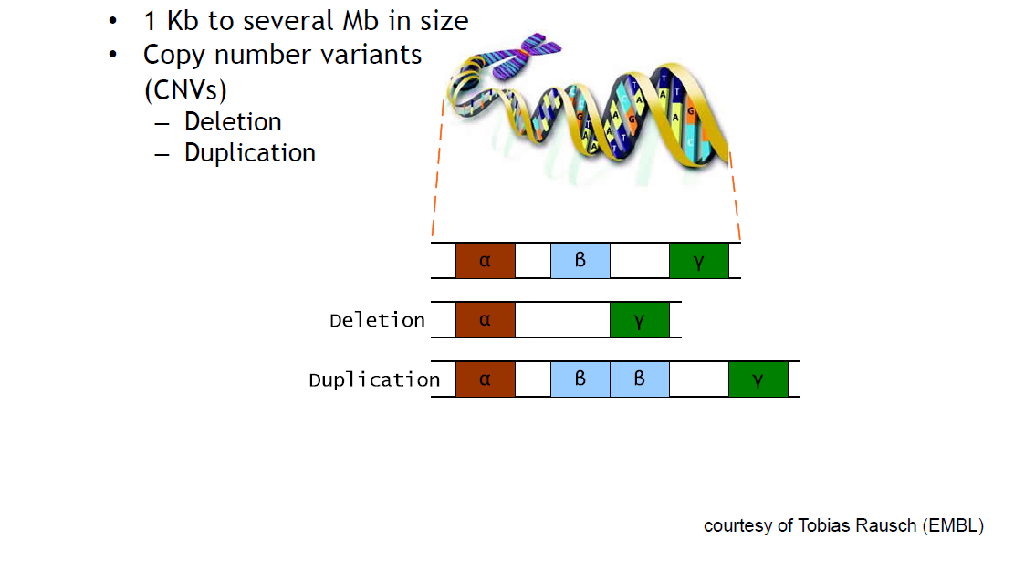
Structural Variations (SV)

Slide 5
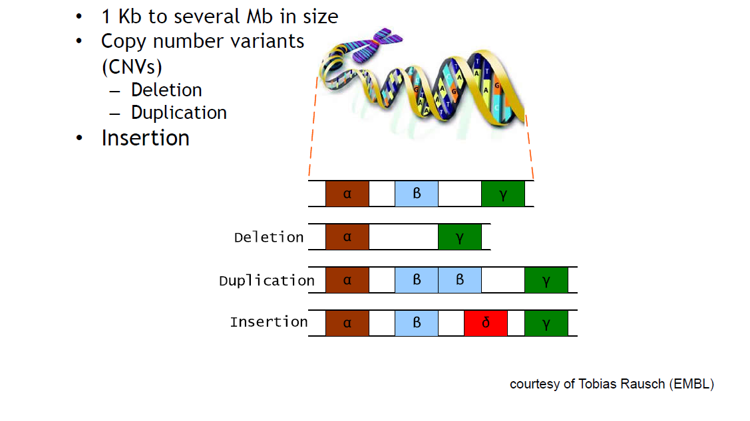
Structural Variations (SV)

Slide 6
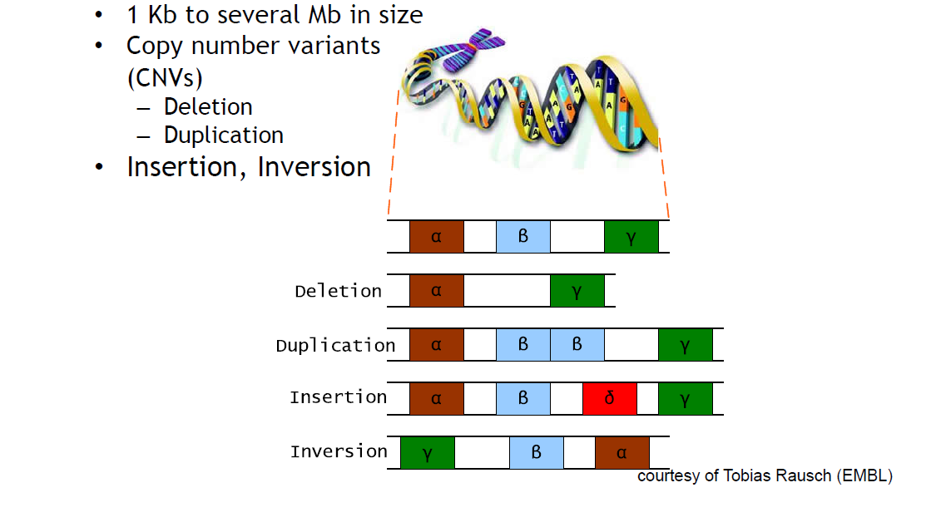
Structural Variations (SV)

Slide 7
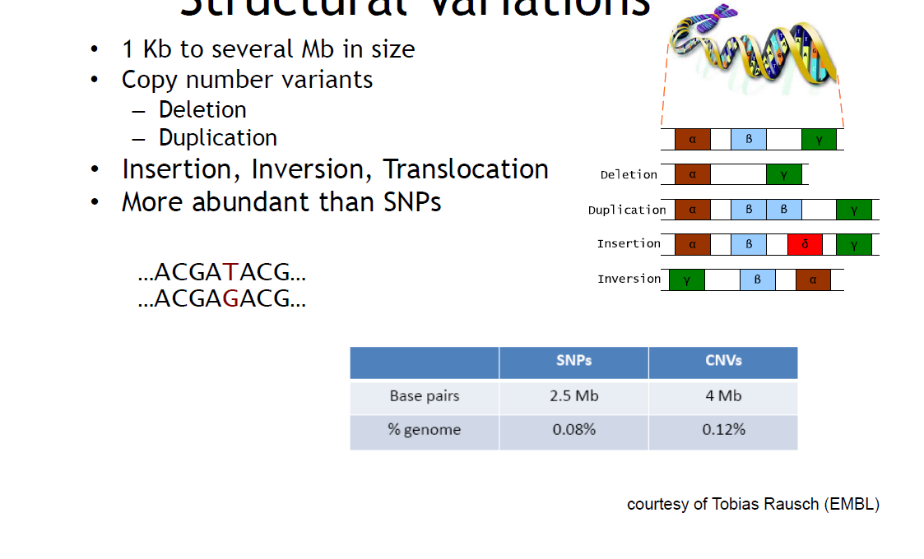
Structural Variations (SV)

Slide 8
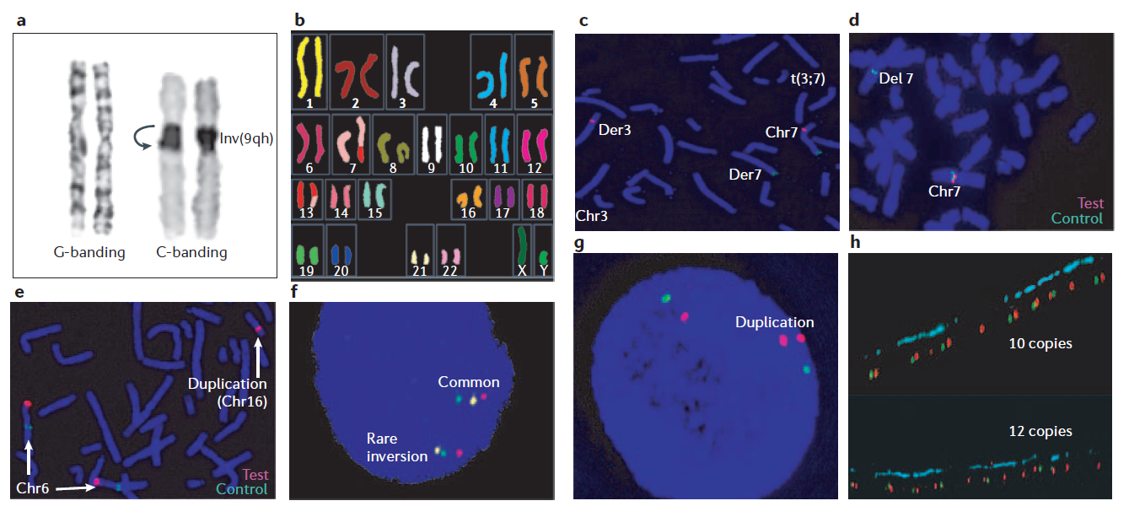
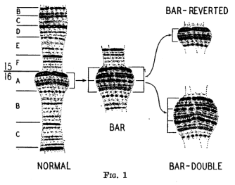
Balanced SV versus Unbalanced SV
Intrachromosomal SV
Interchromosomal SV
INVERSION (INV)
RECIPROCAL TRANSLOCATION (RT)
Balanced SV
ref
ref
SV
SV
DELETION (DEL)
TANDEM DUPLICATION (DUP)
INSERTION (INS)
Unbalanced SV (CNV)
ref
ref
SV
SV
Pictures adapted from Feuk et al., 2006 Nature Reviews
Calvin Blackman Bridges, Science

Slide 9
Why Discover SV ?
involved in > 30 diseases (Psoriasis, Crohn disease, ASD…)
chromosomal instability detected in the vast majority of cancers
powerful mechanism of adaptation and evolution

Slide 10
SV detection technologies

Slide 11
Timeline of technologies used to discover SV
SV, Structural Variations since 1936
Calvin Blackman Bridges, Science
1936
Comparative cytogenetics
Lejeune, Study of somatic chromosomes from 9 mongoloid children, Hebd Seances Acad Sci
1959
Smith et al, Interstitial deletion of (17)(p11.2p11.2) in nine patients. Am J Med Genet
1986

Slide 12
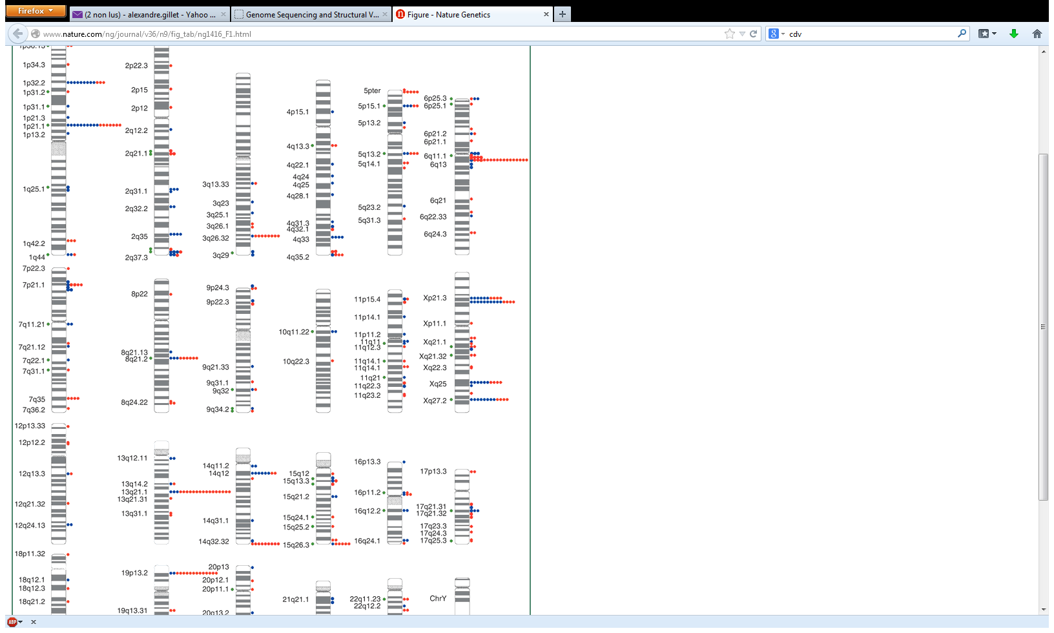
Timeline of technologies used to discover SV
SV, Structural Variations since 1936
Calvin Blackman Bridges, Science
1936
Comparative cytogenetics
Lejeune, Study of somatic chromosomes from 9 mongoloid children, Hebd Seances Acad Sci
1959
Smith et al, Interstitial deletion of (17)(p11.2p11.2) in nine patients. Am J Med Genet
1986
Sebat, Large-scale copy number polymorphism in the human genome, Science
Iafrate, Detection of large-scale variation in the human genome, Nature
2004
200 et 221 CNV
Microarrays
Redon, Global variation in copy number in the human genome, Nature
2006
360 Mb CNVR (12% du génome humain)

Slide 13
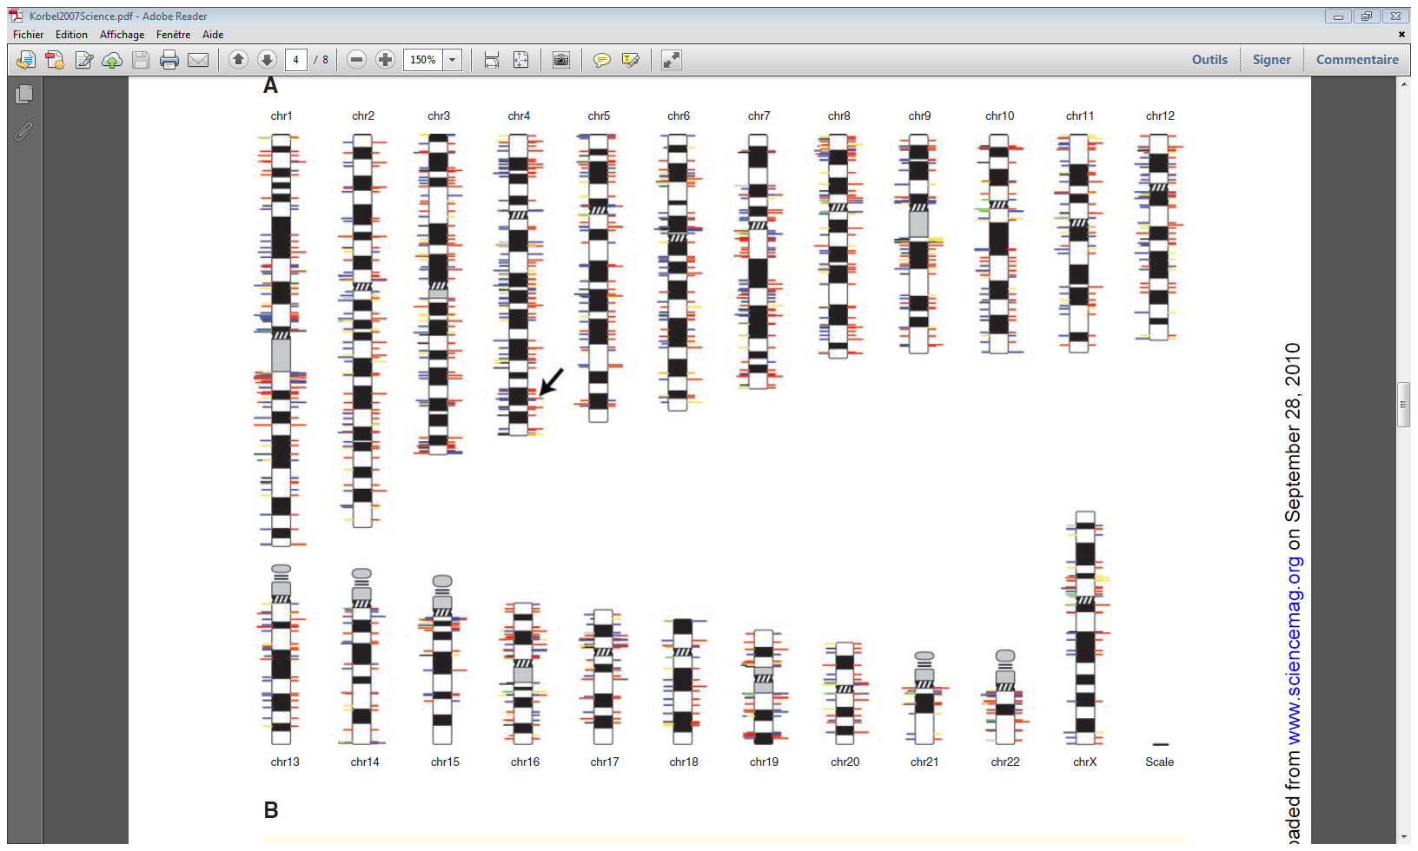
Timeline of technologies used to discover SV
SV, Structural Variations since 1936
Calvin Blackman Bridges, Science
1936
Comparative cytogenetics
Lejeune, Study of somatic chromosomes from 9 mongoloid children, Hebd Seances Acad Sci
1959
Smith et al, Interstitial deletion of (17)(p11.2p11.2) in nine patients. Am J Med Genet
1986
Sebat, Large-scale copy number polymorphism in the human genome, Science
Iafrate, Detection of large-scale variation in the human genome, Nature
2004
200 et 221 CNV
Microarrays
Redon, Global variation in copy number in the human genome, Nature
2006
360 Mb CNVR (12% du génome humain)
Korbel et al, Paired-end mapping reveals extensive structural variation in the human genome, Science
2007
1 000 SV
NGS
1000 HGP, A map of human genome variation from population-scale sequencing, Nature
2010
20 000 SV

Slide 14
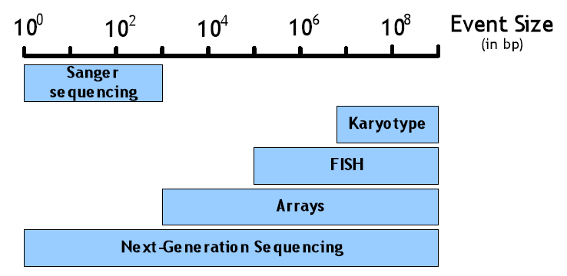
‘Range of usability’ of technologies
Size limit
SV type limit

Slide 15
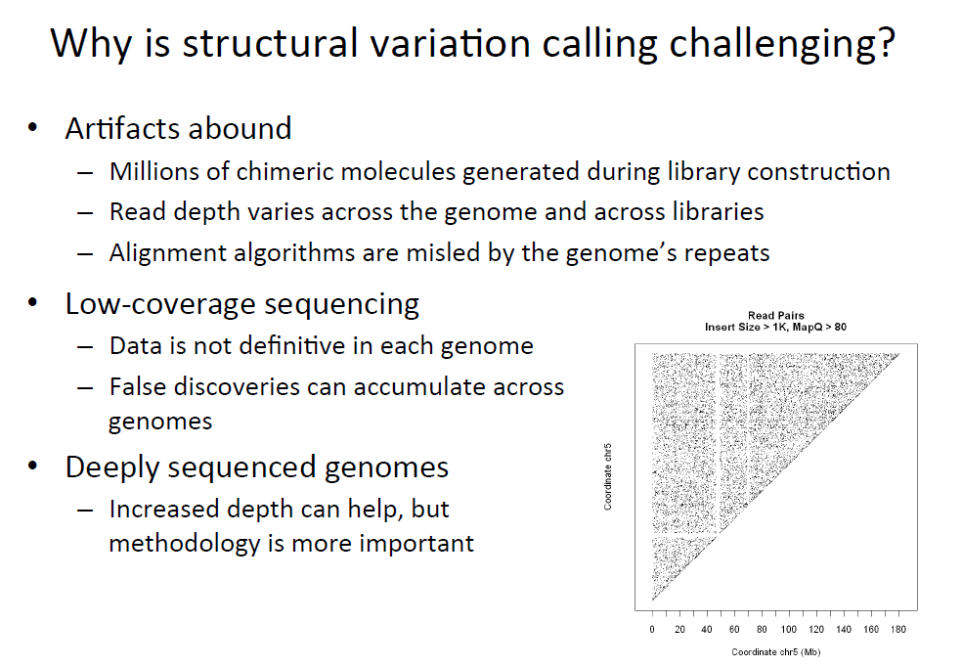

Slide 16
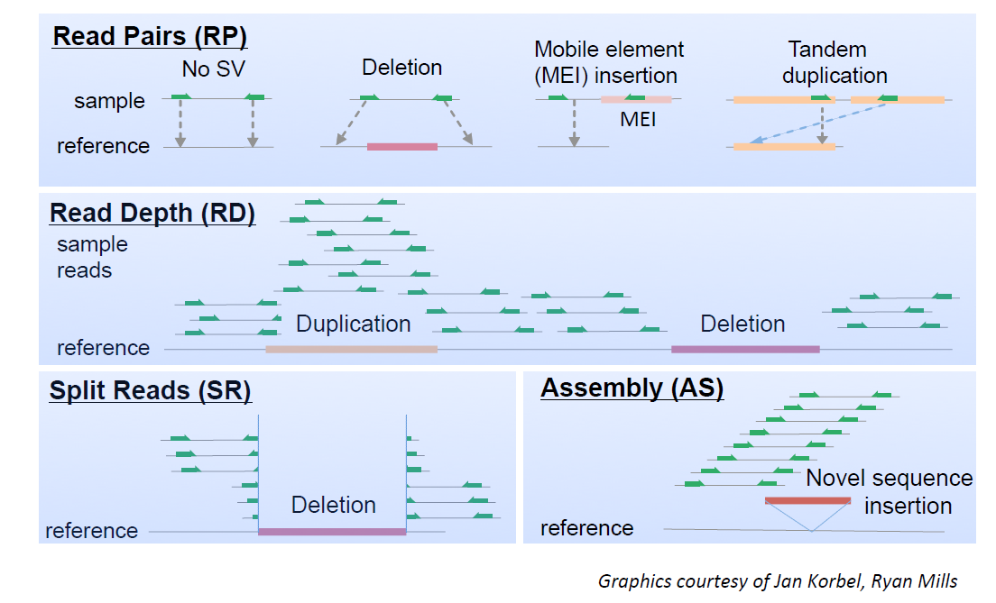
SV detection with NGS data

Slide 17
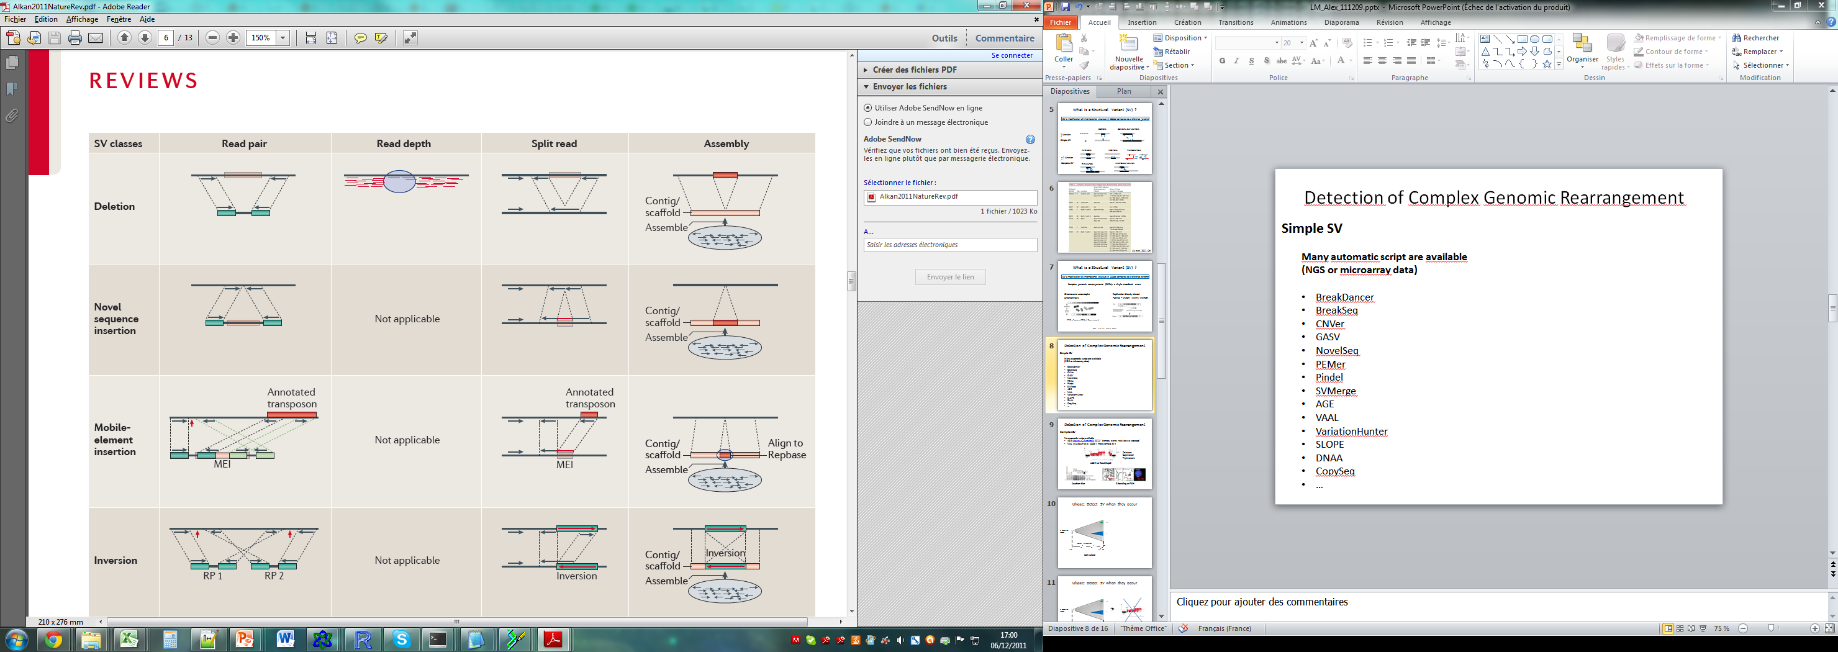
How to detect SV with NGS data ?
Quinlan & Hall 2011 Trends in Genetics
Breakpoints res.
SV size range
CNV
Balanced SV
FDR
Missing rate
1-10 bp
>10 bp
Yes
No
High?
High?
1 bp
1 bp–50 kbp
Yes
Yes
>10%
>25%
1 bp
>1 bp
Yes
Yes
low
High?
>100 bp
> Insert Size
Yes
Yes
Variable
Variable
LI 2011 Nature

Slide 18
Read pairs: 2 types of Illumina genomic DNA libraries
1) Illumina Paired-End
2) Illumina Mate-Pair

Slide 19
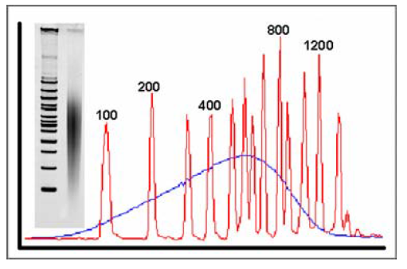
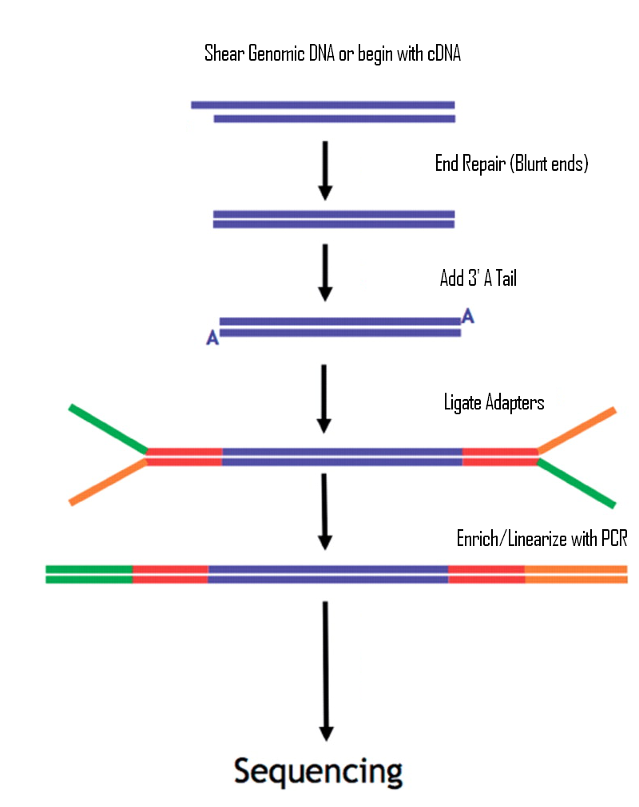
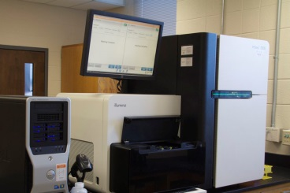
1) Illumina Paired-End

Slide 20
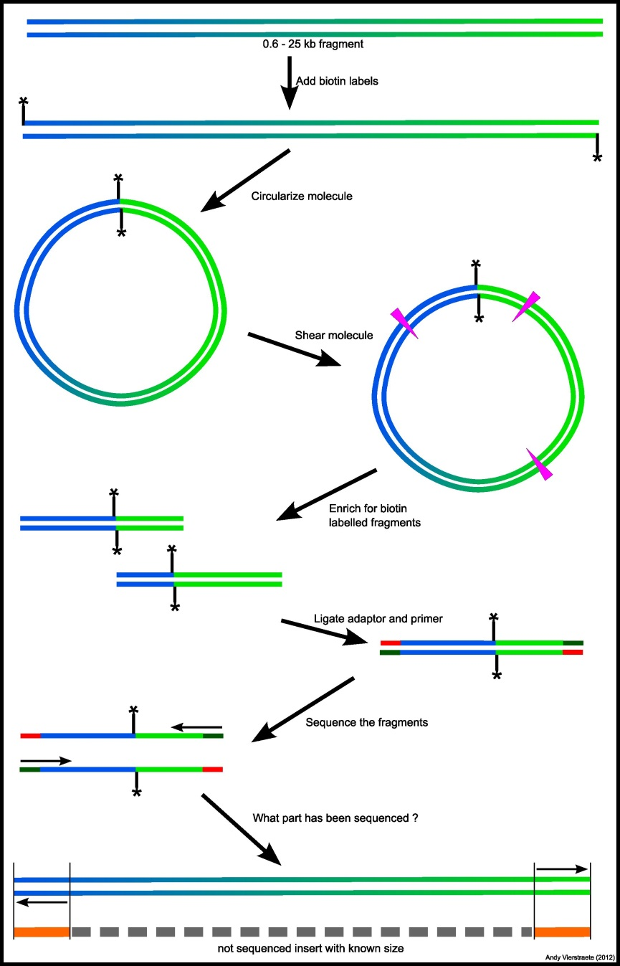
2) Illumina Mate-Pair

Slide 21
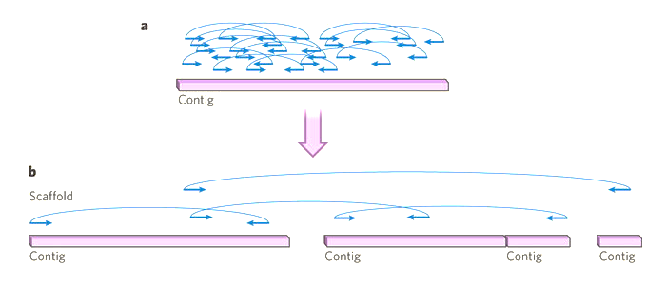
Illumina Paired end vs Mate-Pair
(MP allows a better genome assembly than PE)
MP allows to detect SV that involve repeated elements

Slide 22
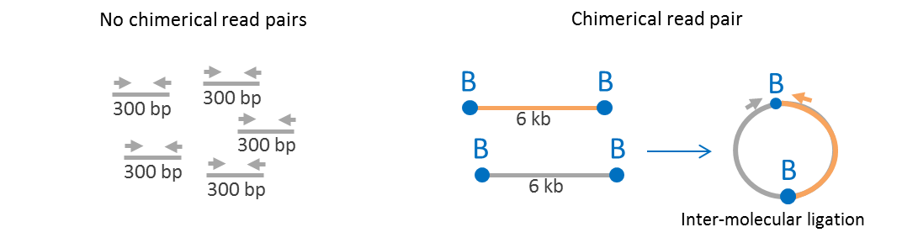
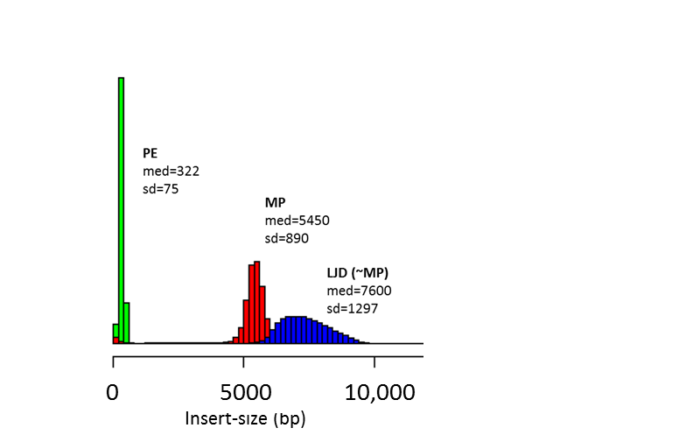
Illumina Paired end vs Mate-Pair
(or much less…)
Insert-size distribution of 100,000 read-pairs
5,000
Insert-size (bp)

Slide 23
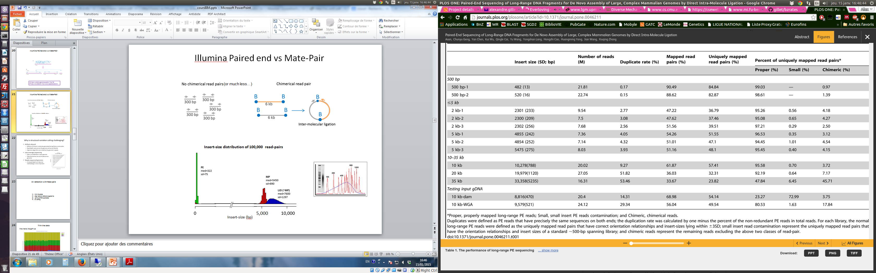
Illumina Paired end vs Mate-Pair

Slide 24
SV detection with Read pairs
trim the data
align data to reference genome
remove PCR duplicates
SV calling

Slide 25
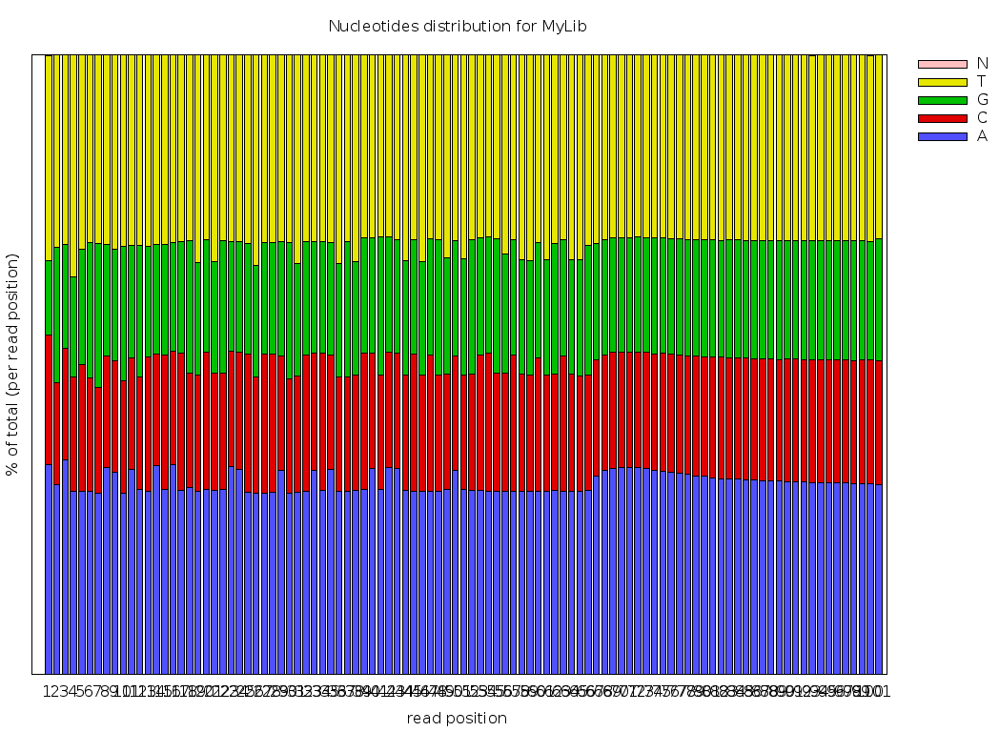
Trim the data
First criteria: Chargaff rule

Slide 26
Trim the data
First criteria : %A = %T and %G = %C on both DNA strands

Slide 27
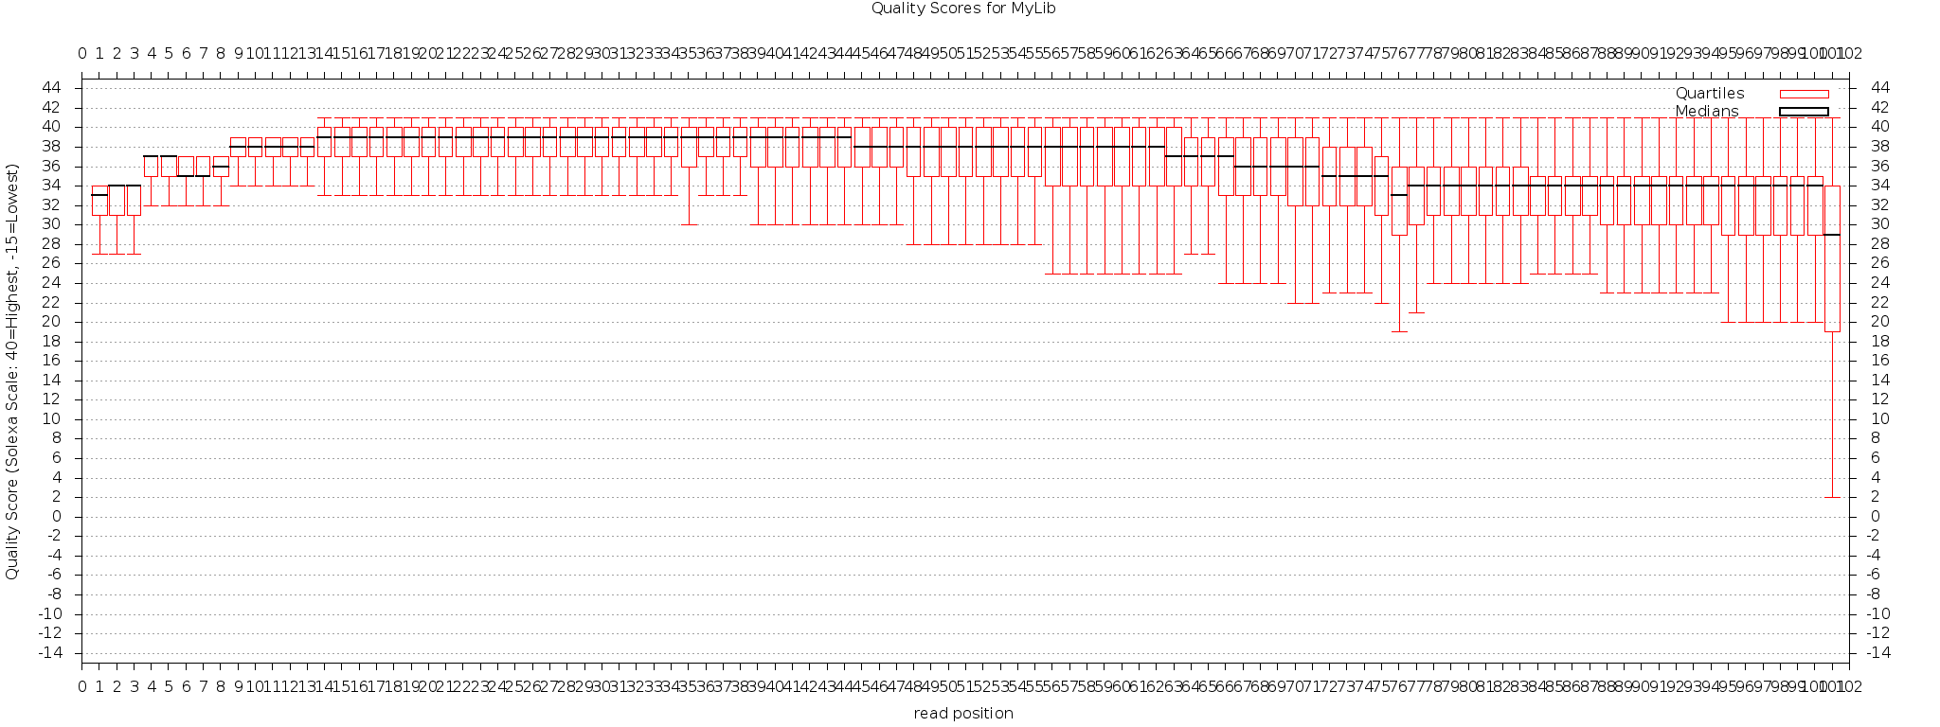
Trim the data
Second criteria: nucleotide quality
Trimming tools
Bcbio-nextgen
Btrim
CANGS
Chipster
Clean reads
ConDeTri
Ea-utils
Fastx
Flexbar
PRINSEQ
Reaper
SeqTrim
Skewer
SolexaQA
TagCleaner
Trimmomatic

Slide 28
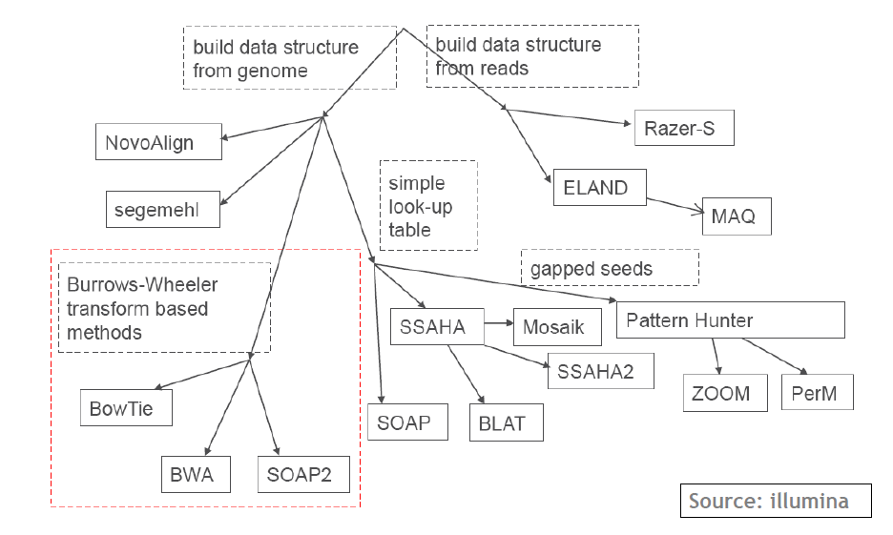
Align the data to reference genome

Slide 29
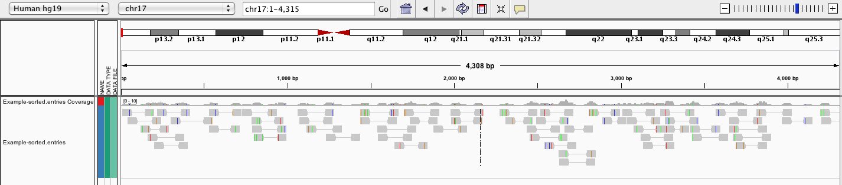
Remove PCR duplicates
PCR duplicates annotation tools
samtools rmdup (only intra-molecular duplicates)
markduplicates.jar (picard tools)
FastUniq
…

Slide 30
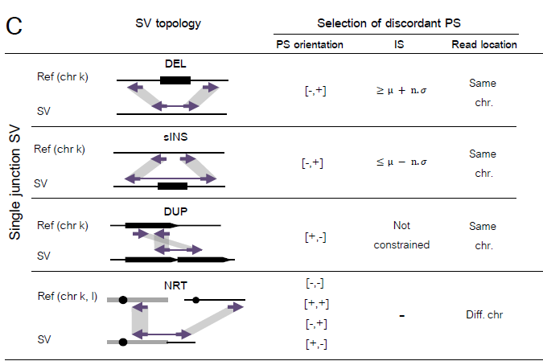
SV signatures
SV have nearly identical signatures with MP and PE

Slide 31
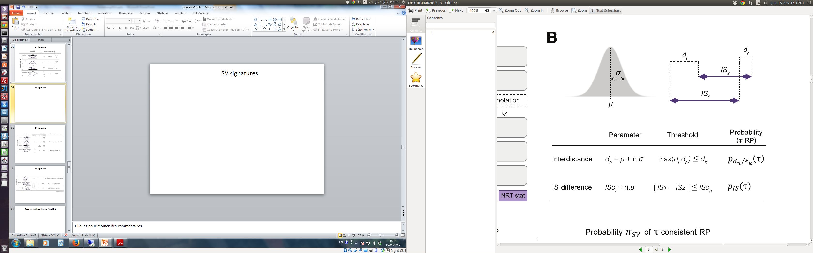
SV signatures
Gillet-Markowska, 2014, Bioinformatics

Slide 32
SV signatures

Slide 33
SV signatures

Slide 34
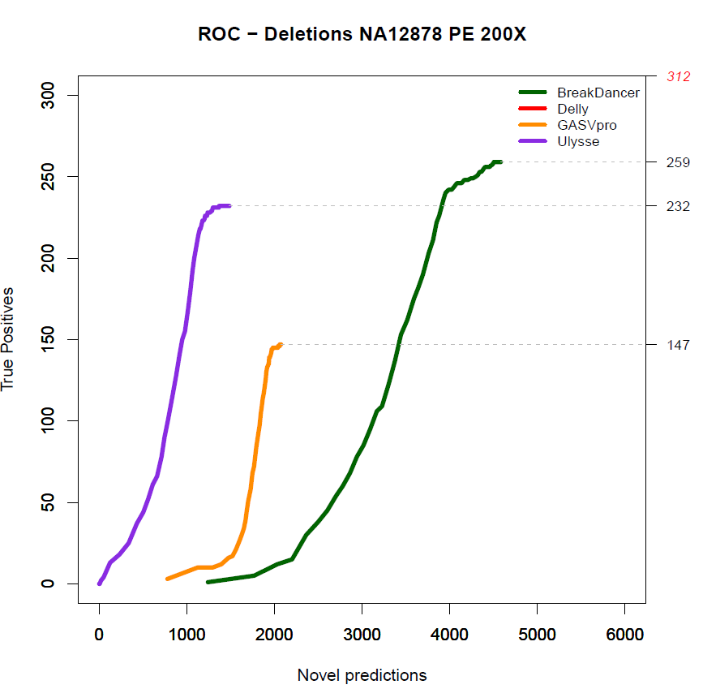
Inter-tool variability is immense

Slide 35
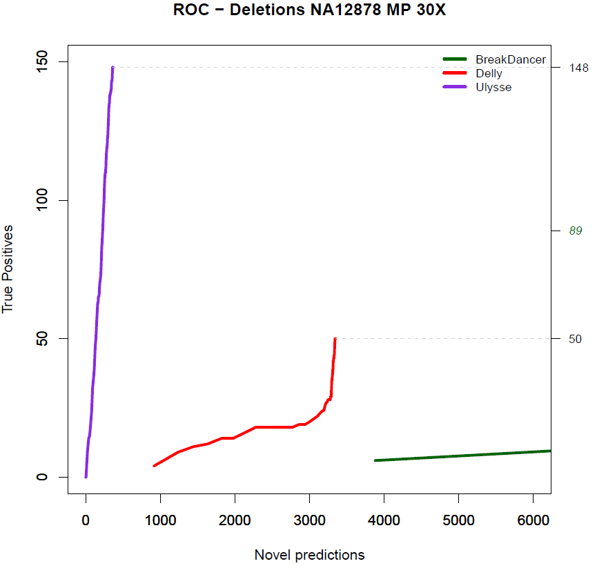
Inter-tool variability is immense

Slide 36
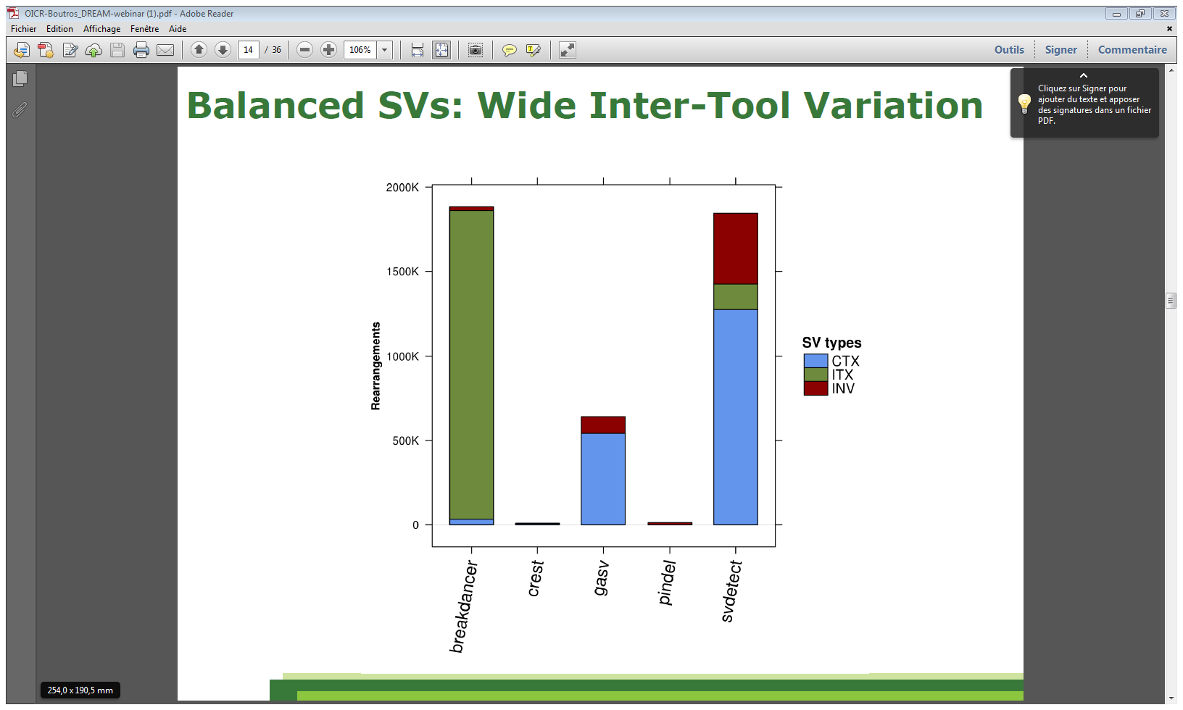
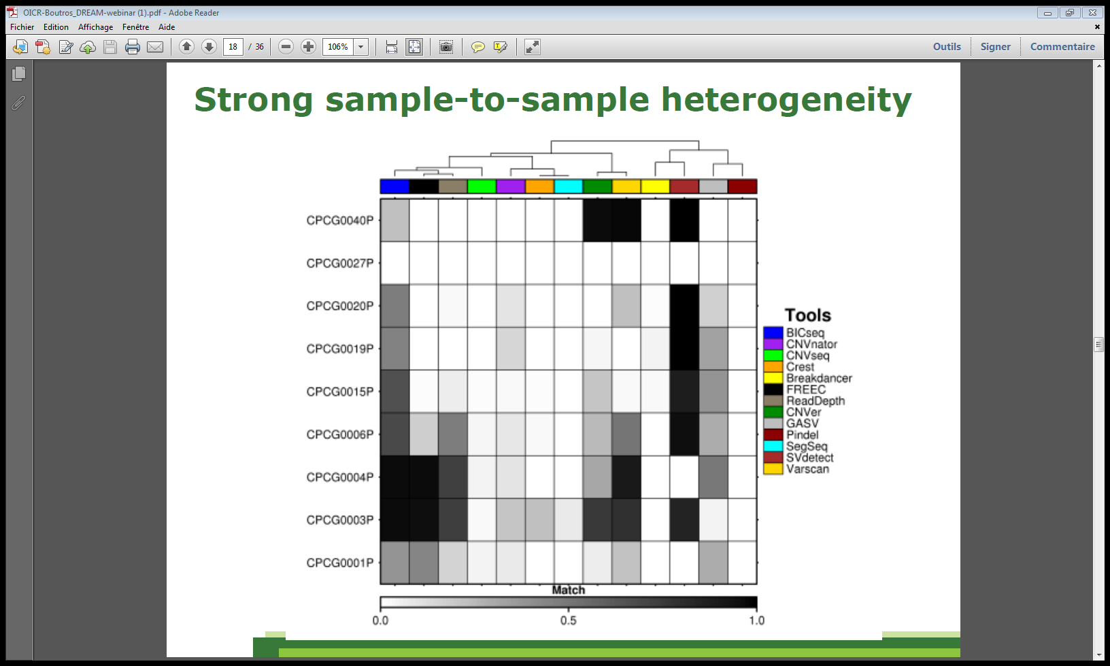
Inter-tool variability is immense
Adapted from ICGC-TCGA challenge

Slide 37
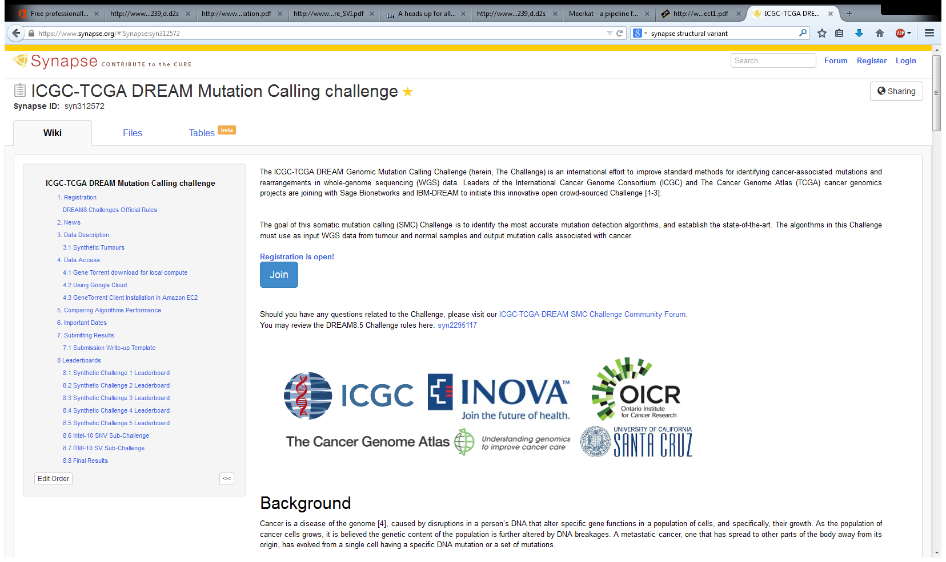
Inter-tool variability is immense

Slide 38
SV examples

Slide 39
SV in the Human genome
Korbel et al, Science 2007

Slide 40
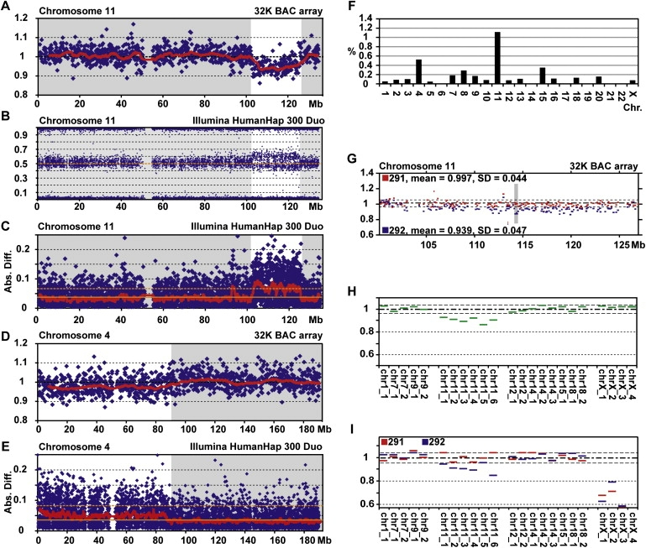
Not-so-identical monozygotic twins
Bruder, C. E. G. et al. Phenotypically concordant and discordant monozygotic twins display different DNA copy-number-variation profiles. Am. J. Hum. Genet. 82, 763–771 (2008)

Slide 41
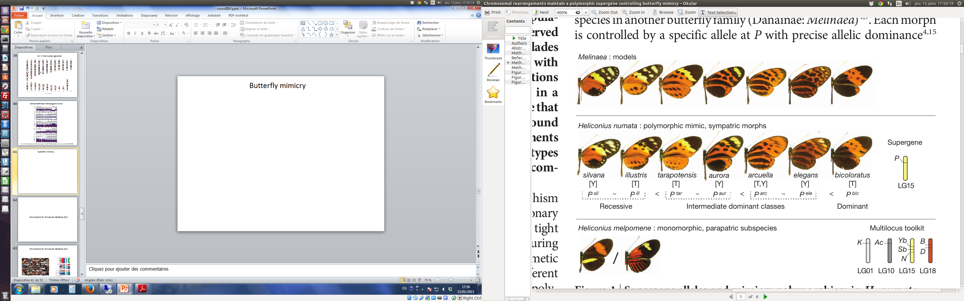
Butterfly mimicry

Slide 42
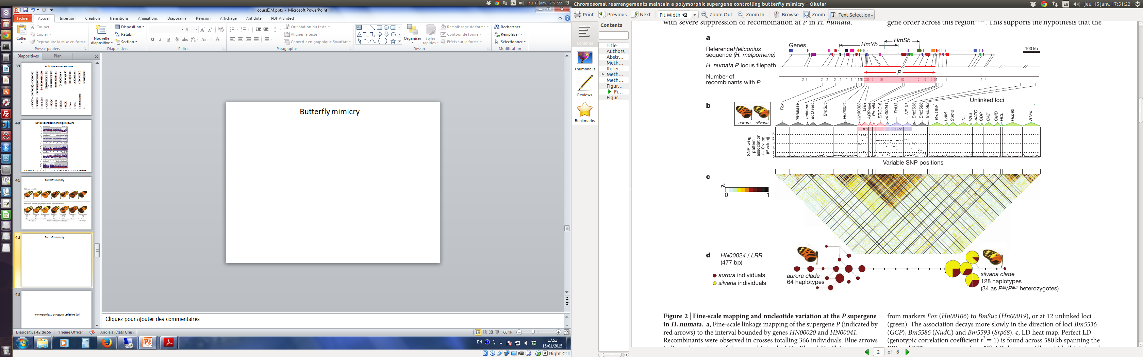
Butterfly mimicry

Slide 43
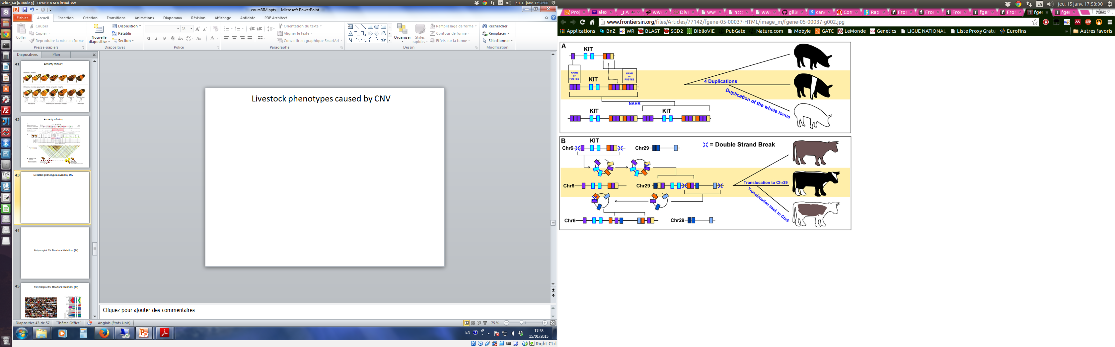
Livestock phenotypes caused by CNV

Slide 44
Polymorphic SV Structural Variations (SV)

Slide 45
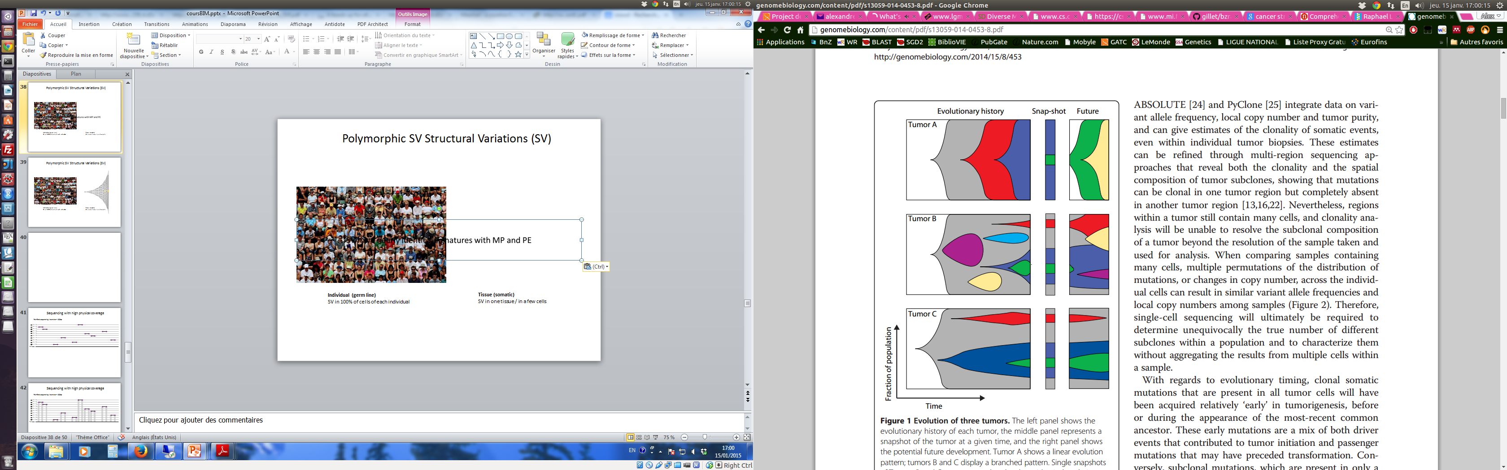
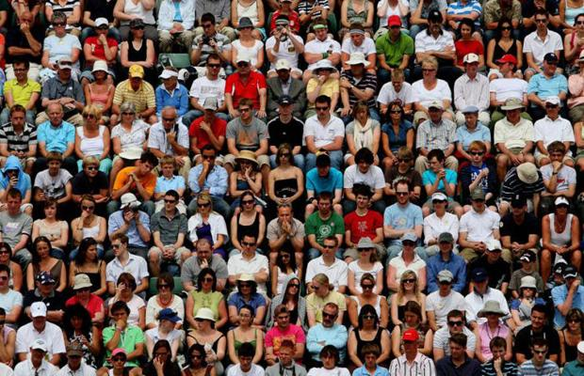
Polymorphic SV Structural Variations (SV)
Individual (germ line)
SV in 100% of cells of each individual
Tissue (somatic)
SV in one tissue / in a few cells

Slide 46
Sequencing a single culture
DNA extraction
Sequencing
(n=80)
S. cerevisiae
DNA extraction
Sequencing
#cells
1
2
4
10⁹
Bottleneck 1
Bottleneck 2
Bottleneck 3
Bottleneck 4
Bottleneck 5
Bottleneck 80
#generation
0
30
60
90
120
150
2400
Can we detect de novo SV occurring in a single cell culture by high throughput sequencing ?
# generations
0
1
2
11
12
13
14
30
# cells
1
2
4
10³
2.10³
8.10³
1.6.10⁴
10⁹
700X
6,000X
The physical coverage (theoretically) sets the detection threshold
Notes:
etected by measuring the rate of the simultaneous loss of the CAN1 and URA3 markers located in the terminal nonessential part of chromosome V
<numéro>

Slide 47
Sequencing with high physical coverage
Pair-End sequencing: insert size ~ 400 bp
Cell 1
Cell 2
Cell 3
Cell 4
Cell 5
Cell 6
Cell 7
Cell 8
Cell 9
Cell 10
Reference

Slide 48
Sequencing with high physical coverage
Pair-End sequencing: insert size ~ 400 bp
Cell 1
Cell 2
Cell 3
Cell 4
Cell 5
Cell 6
Cell 7
Cell 8
Cell 9
Cell 10
Reference

Slide 49
Sequencing with high physical coverage
Pair-End sequencing: insert size ~ 400 bp
Cell 1
Cell 2
Cell 3
Cell 4
Cell 5
Cell 6
Cell 7
Cell 8
Cell 9
Cell 10
Reference
Coverage (sequence)
cov_{seq} = 0.5X
2
1
0

Slide 50
Sequencing with high physical coverage
Pair-End sequencing: insert size ~ 400 bp
Cell 1
Cell 2
Cell 3
Cell 4
Cell 5
Cell 6
Cell 7
Cell 8
Cell 9
Cell 10
Reference
Coverage (sequence)
cov_{seq} = 0.5X
2
1
0
Coverage (physical)
cov_{phys} = 0.85X
2
1
0

Slide 51
Sequencing with high physical coverage
Pair-End sequencing: insert size ~ 400 bp
Cell 1
Cell 2
Cell 3
Cell 4
Cell 5
Cell 6
Cell 7
Cell 8
Cell 9
Cell 10
Reference
Coverage (sequence)
cov_{seq} = 0.5X
2
cov_{SV} = 0
1
0
cov_{SV} = 0
Coverage (physical)
cov_{phys} = 0.85X
2
1
0

Slide 52
Sequencing with high physical coverage
Mate Pair sequencing: insert size ~ 1 to 20 kb
Cell 1
Cell 2
Discordant Paired Sequence
Cell 3
Cell 4
Cell 5
Cell 6
Cell 7
Cell 8
Cell 9
Cell 10
Reference

Slide 53
Sequencing with high physical coverage
Mate Pair sequencing: insert size ~ 1 to 20 kb
Cell 1
Cell 2
Discordant Paired Sequence
Cell 3
Cell 4
Cell 5
Cell 6
Cell 7
Cell 8
Cell 9
Cell 10
Reference
Coverage (sequence)
cov_{seq} = 0.5X
2
1
0
Coverage (physical)
10
8
cov_{phys} = 5X
6
cov_{SV} = 1
4
2
0
Mate Pair sequencing increases the sensitivity of SV detection

Slide 56
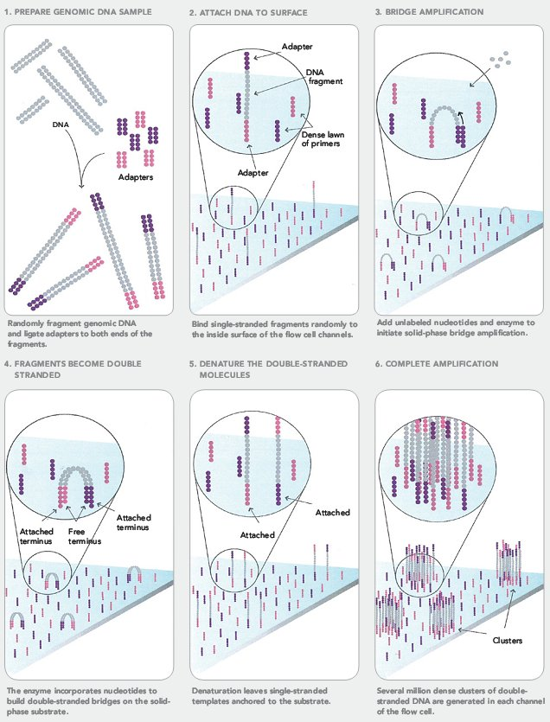
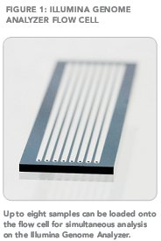
Illumina Paired-End

Slide 57
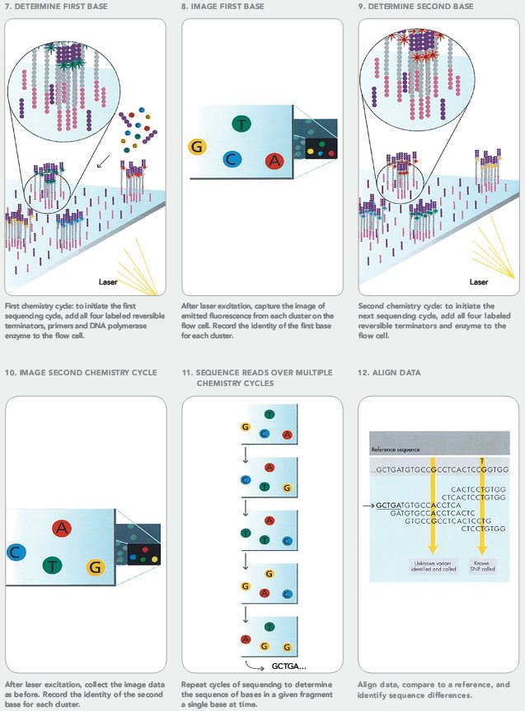
Illumina Paired-End

